Slide 1
Lecture 5
Rank-reduction of Tensors or Multilinaer arrays examples
M D Sacchi
University of Alberta

Slide 2
Some Examples of 5D reconstruction
Moving to Tensors..
5D ?

Slide 3

Source receiver coordinates
: Source
: Receiver

Slide 4
Source receiver coordinates
: Source
: Receiver

Slide 5
Midpoint-offset coordinates
: Source : Midpoint
: Receiver

Slide 6
Midpoint-offset coordinates
: Source : Midpoint
: Receiver

Slide 7
Midpoint-offset coordinates
: Source : Midpoint
: Receiver

Slide 8
5D data (4 spatial coordinates + time)
Source Receiver coordinates
Midpoint, inline and cross-line offsets
Midpoint, offset and azimuth

Slide 9
5D data (4 spatial coordinates + frequency)
Source Receiver coordinates
Midpoint, inline and cross-line offsets
Midpoint, offset and azimuth
We often work with one 4D cube per frequency

Slide 10
Fourier Industrial modules for ND reconstruction
MWNI (Minimum Weighted Norm Interpolation)
ALFT (Anti leakage Fourier Transform)
POCS (Projection onto Convex Sets)
Sparse Fourier Reconstruction
Matching Pursuit Reconstruction
and 10¹⁰ versions of the aforementioned algorithms
All of the above assume a sparse (simple) distribution of Fourier Coefficients.
Different solvers but similar concepts/assumptions are used
Tricks make them robust (as always)
I/O and patching strategies are extremely important
Operators
NUDFT to honor true coordinates
FFT after Binning
Could replace Fourier kernels by any localized transform

Slide 11
Rank reduction techniques
So far I have described methods that are based on Fourier synthesis with sparsity/simplicity constraints. These methods are extensively used by industry and the core of the so called 5D Interpolation methods
New classes of methods have started to develop in recent years (based on some old and interesting ideas). They assume that seismic data are low rank tensor structures
Interesting area of research because connects to Data Analytics, Collaborative Filtering, Personalized Medicine etc.

Slide 12
Denoising via rank-reduction
Hemon , C. H., and Mace, D., 1978, Use of the Karhtmen-Lolve
transformation in seismic data processing: Geophys. Prosp., 26, 600-606.
Jones, I. F., 1985, Applications of the Karhunen-Loeve transform in
reflection seismology: Ph.D. thesis, Univ. of British Columbia.
Al-Yahya, K. M., 1991, Application of the partial Karhunen-Loeve
transform to suppress random noise in seismic sections: Geophys. Prosp.,
39, 77–93.
Trickett (2003). ”F‐xy eigenimage noise suppression.” GEOPHYSICS, 68(2),
751-759.

Slide 13
From Trickett GEO-2003

Slide 14
Recommender System
A recommendation system (or recommender system) is an algorithm that attempts to predict the rating that a user or customer will give to an item. Recommendation systems have become quite popular in the field of e-commerce for predicting ratings of movies, books, news, research articles etc.

Slide 15
Netflix Prize
From http://www.netflixprize.com/
“The Netflix Prize sought to substantially improve the accuracy of predictions about how much someone is going to enjoy a movie based on their movie preferences'’
Netflix provided a training data set of 100,480,507 ratings that 480,189 users gave to 17,770 movies (only 1.17% of the elements of the data table/matrix are known)
On September 21, 2009 Netflix awarded the $1M Grand Prize to team BellKor’s Pragmatic Chaos.

Slide 16
Matrix/Tensor Completion and the famous NETFLIX problem
Hypothetical portion of the Netflix matrix

Slide 17
Matrix completion with minimal math
For Matrix completion
For Tensor completion
Or, using min Nuclear Norm
N. Kreimer, A. Stanton and M. D. Sacchi, 2013, Tensor completion based on nuclear
norm minimization for 5D seismic data reconstruction, Geophysics, 78 (6), V273-V284.

Slide 18
Rank (Review)
The number of linearly independent columns of the matrix A is called the rank of A.
A matrix is said to have full rank if all columns are linearly independent

Slide 19
Full Rank, rank = 4
1 0 1 -1
1 0 -3 -1
0 2 2 0
0 -1 -1 -1

Slide 20
Rank deficient, rank = 1
1 2 3 4
1 2 3 4
1 2 3 4
1 2 3 4

Slide 21
Rank deficient, rank = 1
0 0 0 0
0 0 0 0
0 0 0 0
1 1 1 1
2 2 2 2
1 1 1 1
0 0 0 0
0 0 0 0
0 0 0 0

Slide 22
Low-rank Approximation and SVD
Assumption: Data can be approximated by a matrix of rank r

Slide 23
Algorithm
Simple matrix completion algorithm
The algorithm can be derived by minimizing a cost function constrained by the assumption that the unknown image can be approximated by a low-rank matrix

Slide 24
Algorithm
Simple matrix completion algorithm
Insert existing data
Replace low rank approximation in pixels with missing data

Slide 25
Constantine the Great (c. 280-337)

Slide 26
Constantine the Great after decimation

Slide 27
Constantine the Great after reconstruction

Slide 28
Constantine the Great – original image

Slide 29
Constantine the Great – Singular values

Slide 30
Why tensors ?

Slide 31
Sampling
5D volumes are irregularly sampled in space due to
Logistic constraints
Insufficient equipment
Acquisition costs
Provincial/Municipal regulations
Environmental constraints
Fold Map

Slide 32
PMF (Xu et al., 2013)
In the Parallel Matrix Factorization method we minimize
Subject to

Slide 33
Unfolding and folding

Slide 34
Reconstruction algorithm
The math leads to a simple algorithm

Slide 35
Reconstruction algorithm
In PMF

Slide 36
Synthetic

Slide 37
Synthetic

Slide 38
Linear and curved events SNR=1

Slide 39
Field data example (WCB)

Slide 40
Fold Map

Slide 41
Processing Parameters
5m X 5m CMP Bins
100m offset sectors (x and y)
300 CMPx and 220 CMPy bins
All survey was divided in 2640 overlapping blocks
Each block has about 85% of missing traces (15% alive)
First part of analysis is with reconstruction in offset-midpoint

Slide 42
Fix offsets and CMPy
Near offset sector

Slide 43
Fix offsets and CMPx
Near offset sector

Slide 44
Fix offsets and CMPy
Mid range offset sector

Slide 45
Fix offsets and CMPy
Mid range offset sector

Slide 46
Fix CMPx and CMPy
Before and after reconstruction of one CMP

Slide 47
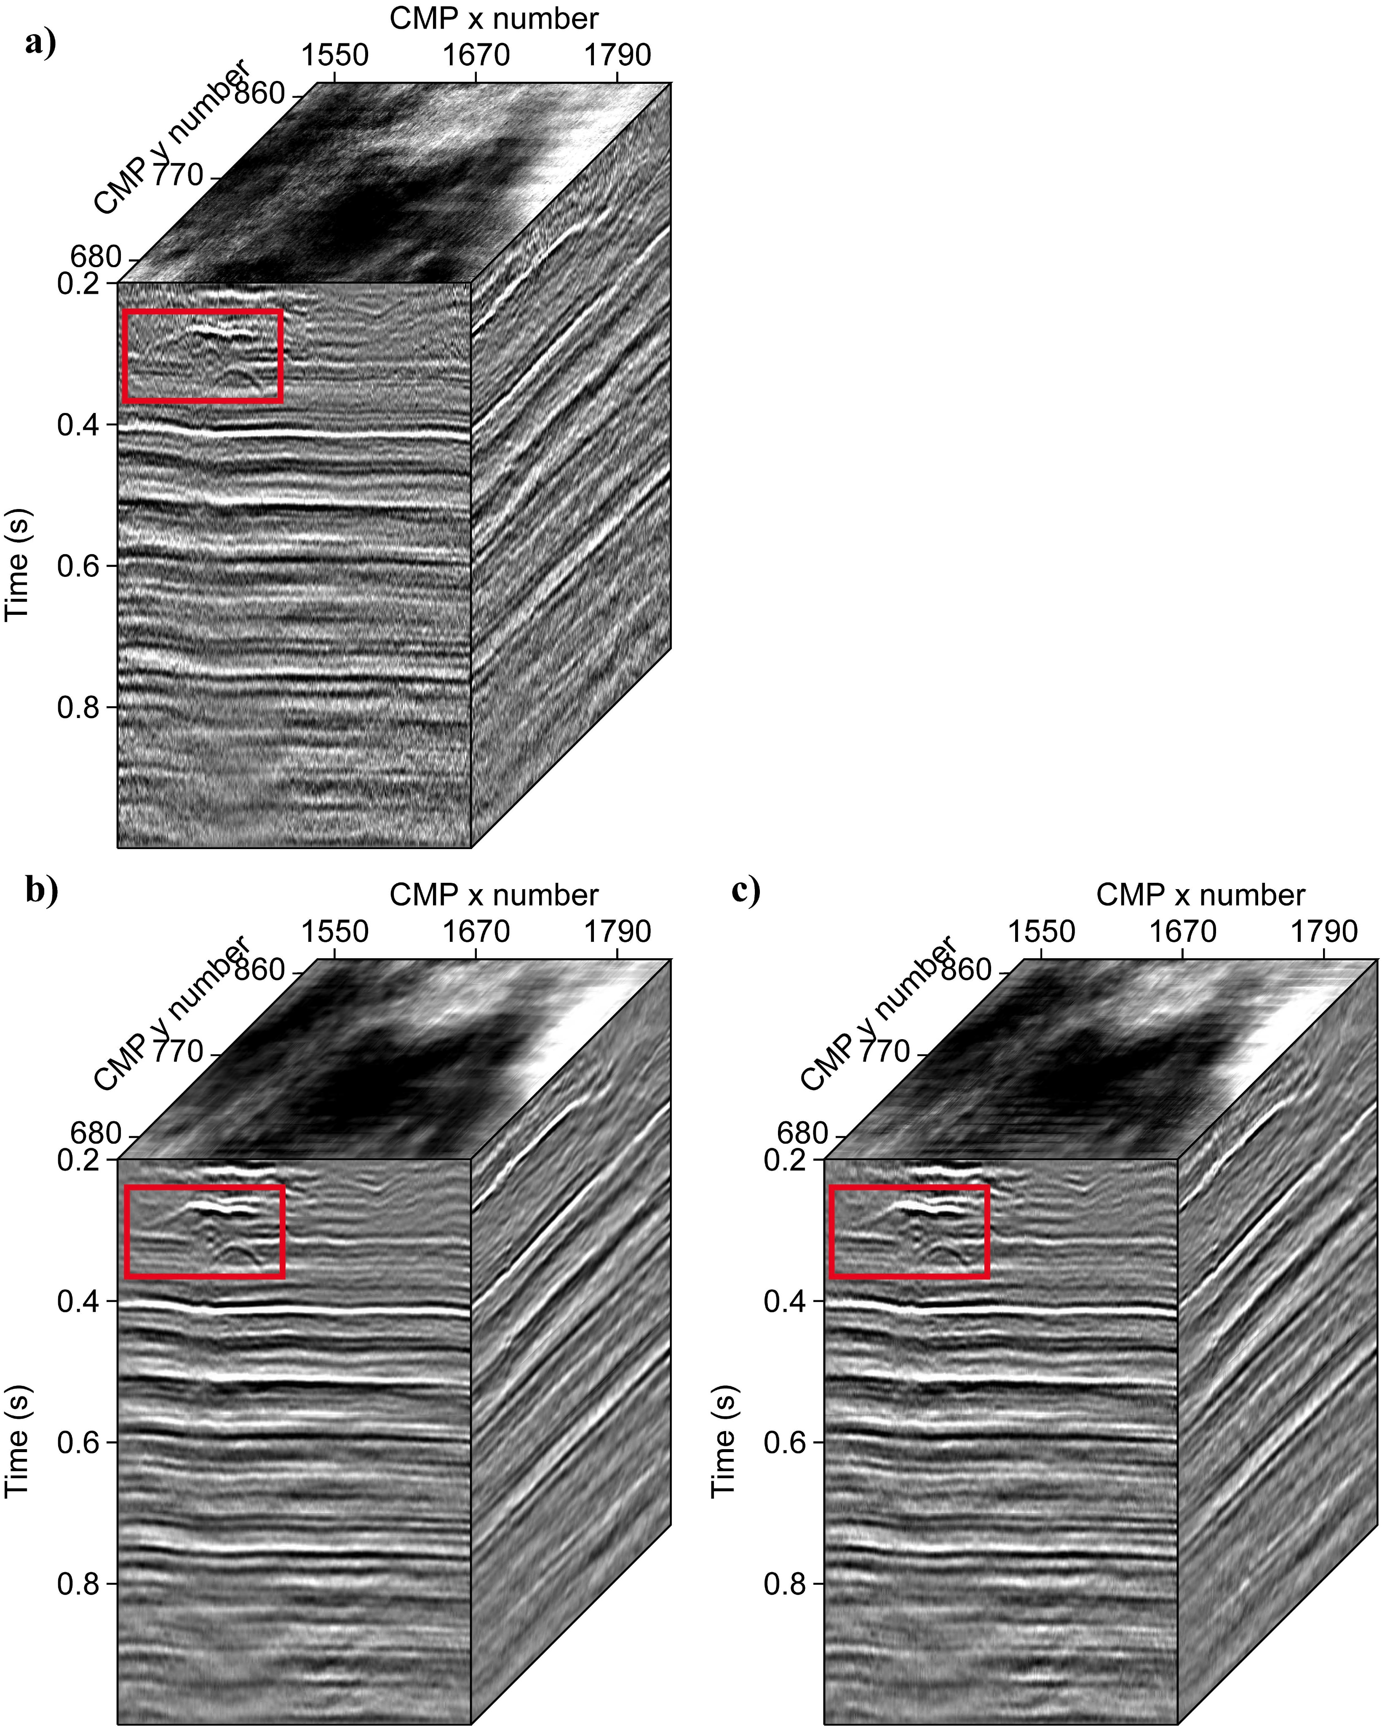
Observations
All traces (Observed + Reconstructed)
Only new traces

Slide 48
Stacks
a) Observations b) All traces (Obs +Reconstructed) c) Only new traces

Slide 49
Stacks
a) Observations b) All traces (Obs +Reconstructed) c) Only new traces

Slide 50
Stacks
a) Observations b) All traces (Obs +Reconstructed) c) Only new traces

Slide 51
Tensor completion in azimuth offset midpoint
Kreimer et al., 2013

Slide 52
Tensor completion in azimuth offset midpoint

Slide 53
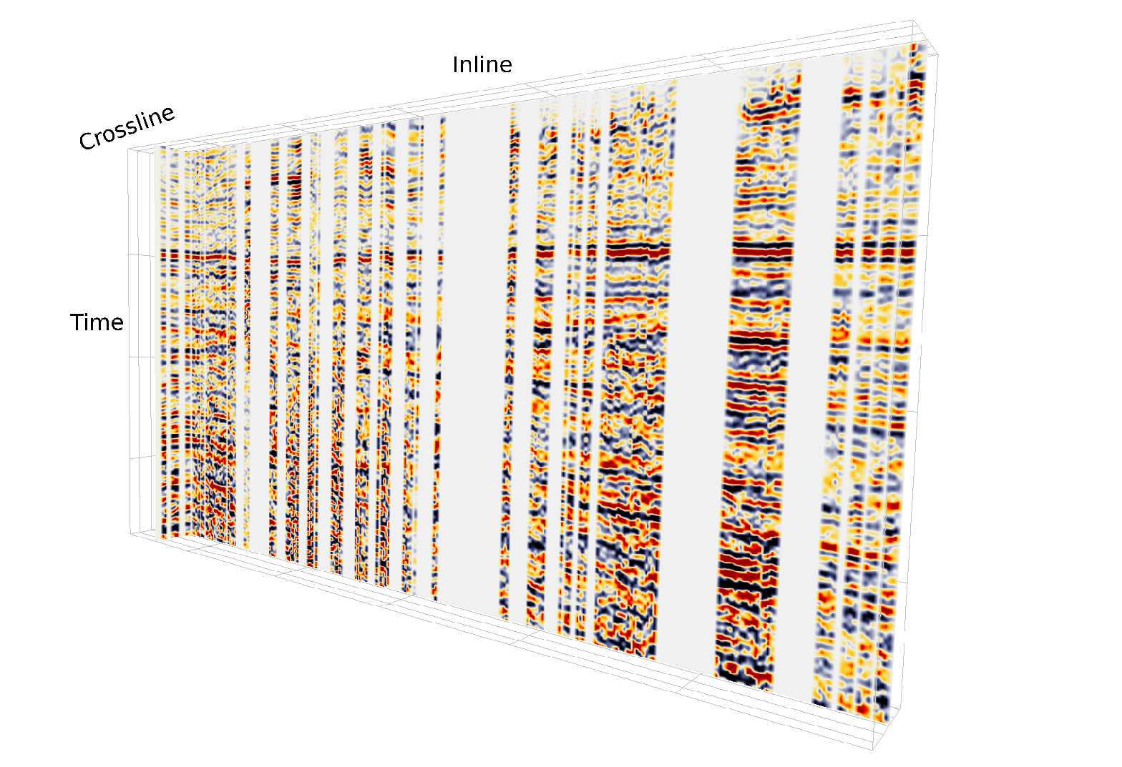

Slide 54
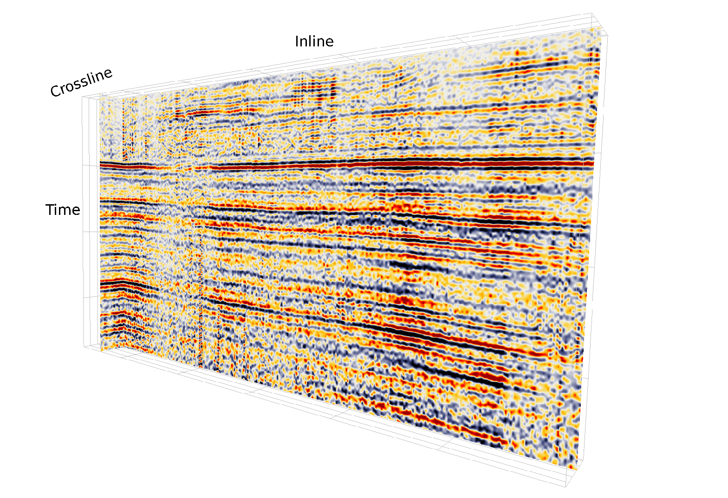

Slide 55
Probability of Success (PMF)
Black: recovery was unsuccessful
White: recovery was successful

Slide 56
References

